Slide 1
ZehenSync AI
A Hybrid Multimodal System for Behavioral Medical Imaging and Psychological Interpretation
Sr. # | Registration# | Name in Full (Use Block Letters)
1 | Ch Hamza Younas | L1F23BSAI0089
2 | Syed Raza Abbas Zaidi | L1F23BSAI0011
3 | Sher Ali Saleem | L1F23BSAI0017

Slide 2
Project Team Introduction
Ch Hamza Younas (AI & Audio Core)
Deploys Whisper/Librosa speech analytics and browser APIs for secure AV data collection.
Codes mathematical scoring (WHO-5/ISI) and establishes secure role-based user features.
Syed Raza Abbas Zaidi (Frontend & UX)
Fine-tunes Gemma 3/Qwen 3 and manages DSM/DSM-5 text data inside ChromaDB.
Develops responsive Next.js web dashboards, telehealth rooms, and interactive PHQ-9/GAD-7 forms.
Sher Ali Saleem (Vision & Infrastructure)
Tracks eye gaze and blink metrics utilizing YOLO v12 and Vision Transformers (ViT).
Integrates backend safety override scripts linked directly to the crisis triggering word library.

Slide 3
Introduction of the Project
Domain:
Mental healthcare faces a dual challenge of lacking objective
behavioral measurement tools and a shortage of AI systems equipped
with deep psychological expertise.
Context:
This project treats behavioral observation as "Behavioral Medical
Imaging," pairing Computer Vision and Speech Analysis with a
psychology-specialized AI.
Motivation:
Standardized assessment scales exist, but there is no integrated
platform that combines visual behavioral imaging and vocal pattern
analysis with clinical interpretation.

Slide 4
Problem Statement & Gap Analysis
Problem Statement:
1. Fragmented Tools: Current tools are isolated. Eye-tracking and
voice analysis tools exist but lack clinical context or intelligent
interpretation.
2. General AI Limits: General-purpose AI models (like GPT or Llama)
lack specialized training on high-level psychological texts (DSM-5,
case studies) and cannot "see" patient behavior.

Slide 5
Proposed Solution / Product Concept
Visual Behavioral Engine:
Treats video as medical data to extract eye biomarkers (blink rate,
gaze patterns).
Speech Analysis Engine:
Analyzes acoustic and linguistic patterns (speech rate, pauses,
fillers) to detect anxiety or distress markers.
Cognitive Explanation Engine:
A Fine-Tuned LLM that acts as the "Psychologist," synthesizing the
video and speech data using expert literature to provide reasoning.

Slide 6
Project Objective
Audio-Visual Biometric Mapping: Correlates gaze, blink rates, and acoustic speech patterns with clinical evaluations. It proves the superiority of multimodal tracking.
Specialized Clinical Intelligence: Compiles a custom "Psyche-Corpus" to fine-tune specialized LLMs. It captures SDOH, It uses a zero-hallucination RAG pipeline grounded in verified DSM-5 data.
Scholar Mode Simulation: Lets students and researchers run case studies on simulated patients. The LLM responds with verified inline citations from DSM-5 and arXiv papers.
Multi-Modal Web Application: Deploys a cloud platform using a Next.js frontend and FastAPI backend. It isolates secure user workflows and generates exportable clinical summaries.

Slide 7
Target Users/Beneficiaries of the Proposed System
1. Psychology Professionals: Reduces cognitive load by automating visual and vocal cue tracking, letting them focus on the patient.
2. Patients: Access an empathetic screening tool and securely book verified local doctors via digital wallets.
3. Psychology Students: Learn clinical analysis using a zero-hallucination textbook tutor and a safe patient simulator.
4. Diagnostic Centers: Standardize screening setups using objective, multi-modal video and audio data layers.
5. Researchers: Utilize open-source tools to study statistical correlations between AI biometrics and expert assessments.
6. University Administrators: Review campus mental health trends and system efficacy using secure, completely anonymized summary reports.

Slide 8
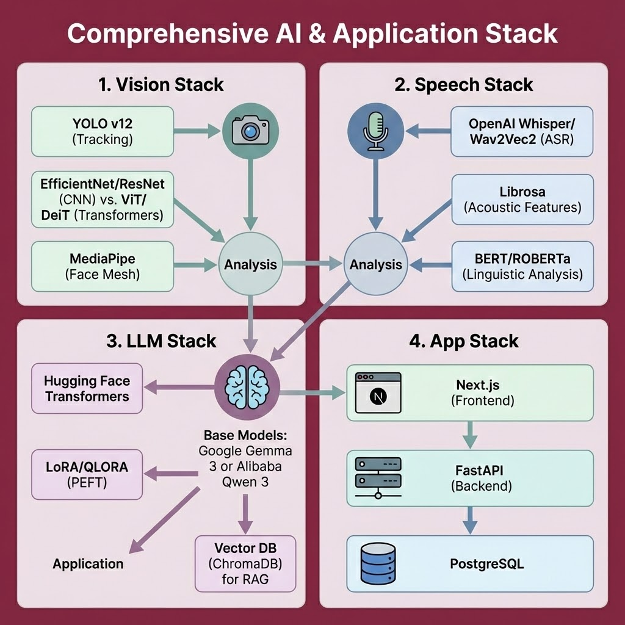
Tools and Technologies
  1. Vision Stack:
  YOLO v12, EfficientNet, ResNet, ViT, DeiT, MediaPipe
  2. Speech Stack:
  OpenAI Whisper, Wav2Vec2, Librosa, BERT, RoBERTa
  3. LLM & Reasoning Stack:
  Google Gemma 3, Qwen 3, Hugging Face, Transformers, LoRA/QLoRA, OpenAI /Openrouter
  4. Database & Storage Stack:
  ChromaDB, PostgreSQL, Google Cloud Storage
  5. App & Framework Stack:
  Next.js, FastAPI, PyTorch, Docker,
  6. OS & Development Ecosystem:
  Windows 11 WSL2

Slide 9
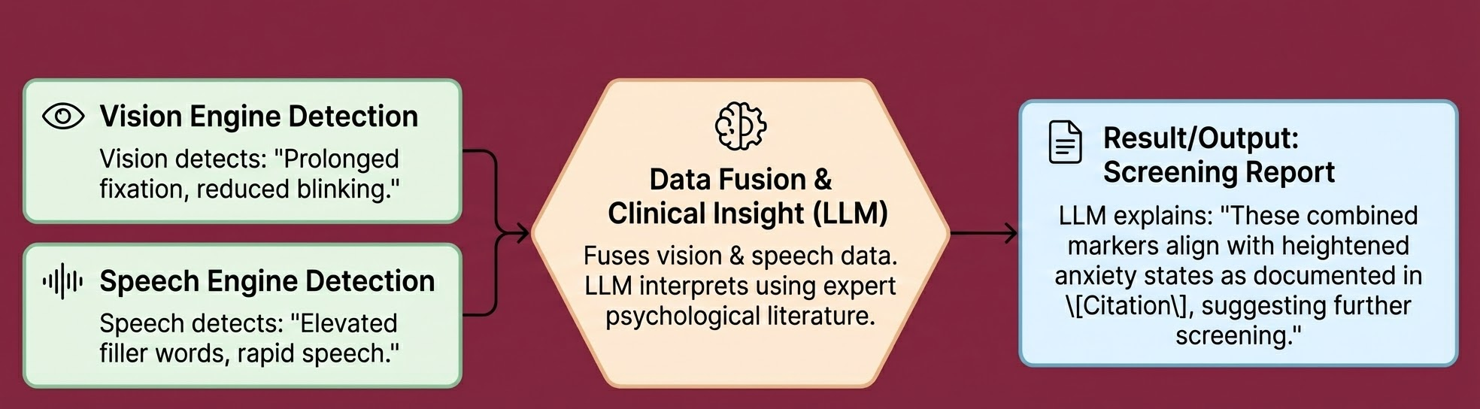
Expected results and product
Product:
A cohesive screening support platform demonstrating three pillars of innovation:
Visual Insight: Objectively measures gaze patterns, fixations, and blink rates.
Vocal Insight: Objectively measures speech rate, filler frequency, and pauses.
Clinical Insight: A Psychology-Expert LLM that contextualizes these metrics to provide evidence-based screening reports.

Slide 10
The Patient Module
Contextual Baseline:
Captures Social Determinants of Health (SDOH) to ensure environmental stress isn't misdiagnosed as a clinical disorder.
Deterministic Testing:
Administers standardized rubrics (e.g., PHQ-9, GAD-7) using dynamic phrasing but strict, clickable scoring for absolute accuracy.
CBT-Guided Interface:
Engages users via an empathetic chatbot trained in Cognitive Behavioral Therapy techniques.
Active Crisis Protocol:
Enforces an immediate "Hard Stop" override to display local emergency resources if high risk is detected.

Slide 11
Clinician Module
Absolute Traceability:
Eliminates the AI "Black Box" by mapping every flagged risk directly back to a specific, timestamped user input.
Longitudinal Tracking:
Calculates baseline changes and score deltas across multiple patient sessions.
Privacy Control:
Anonymizes data by replacing direct identifiers with randomized session IDs for secure review.
Clinical Exports:
Generates structured, data-driven PDF/JSON reports strictly for professional medical oversight.

Slide 12
Scholar Module
Multi-Tier RAG Pipeline:
Grounds all AI responses in verified databases (DSM-5) and academic APIs (arXiv) to completely prevent hallucinations.
Verifiable Citations:
Generates inline citations linked to an interactive UI, allowing students to verify claims directly from source documents.
Adaptive Profiling:
Asynchronously tracks student knowledge gaps to dynamically adjust the AI's teaching complexity.
Isolated Simulation:
Provides a safe environment for diagnostic practice without cross-contaminating real patient data.

Slide 13
Nature of the End Product
Multi-Modal Web Application:
Deployed as a secure, cloud-hosted web platform built with a Next.js frontend and a FastAPI backend architecture.
Automated Screening Tool:
Serves patients as an objective mental health screening interface that extracts and fuses visual, acoustic, and text-based distress markers.
Academic Research Tool & Simulator:
Functions for psychology students as a zero-hallucination textbook tutor and a synthetic patient lab to practice clinical interviewing safely.
Telehealth Software Service (SaaS):
Operates as an open B2B2C clinical marketplace offering verified practitioners automated triage queues, digital escrow wallets, and encrypted video session rooms.

Slide 14
Conclusion:
Why We Chose This Project
Objective & Personal Mission: Combines audio-visual AI biometrics with clinical reasoning to replace subjective screening and break Pakistan's mental health stigma to protect human lives.
Target Market Benefits
Ecosystem Value: Eliminates administrative documentation burnout for practitioners while expanding safe, verified marketplace care for the public.

Slide 15
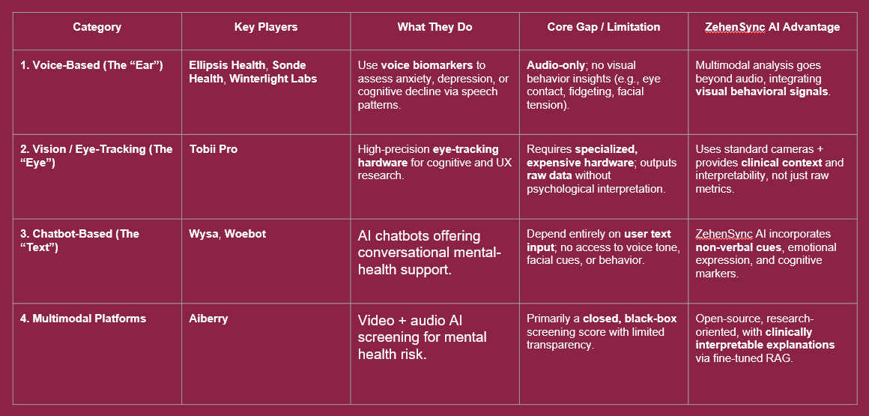
Competitors Analysis

Slide 16
Thanks Slides
Q&A Session

